Slide 1
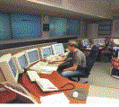

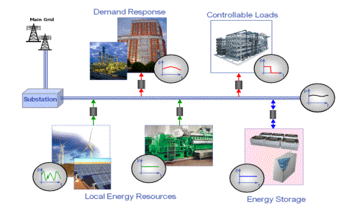





Smart Grid Equipment Monitoring
Operations
EMS/DMS/DA
Business Applications
GIS, Asset Mgmt.
Utility Enterprise
Integrated Network Manager
Mini-Grid
Communications Infrastructure
Smart
grid
devices
LTC
Cap Bank
Xfmr Sensors
AMI
Voltage Regulator
RTU
Relays & IEDs

Slide 2
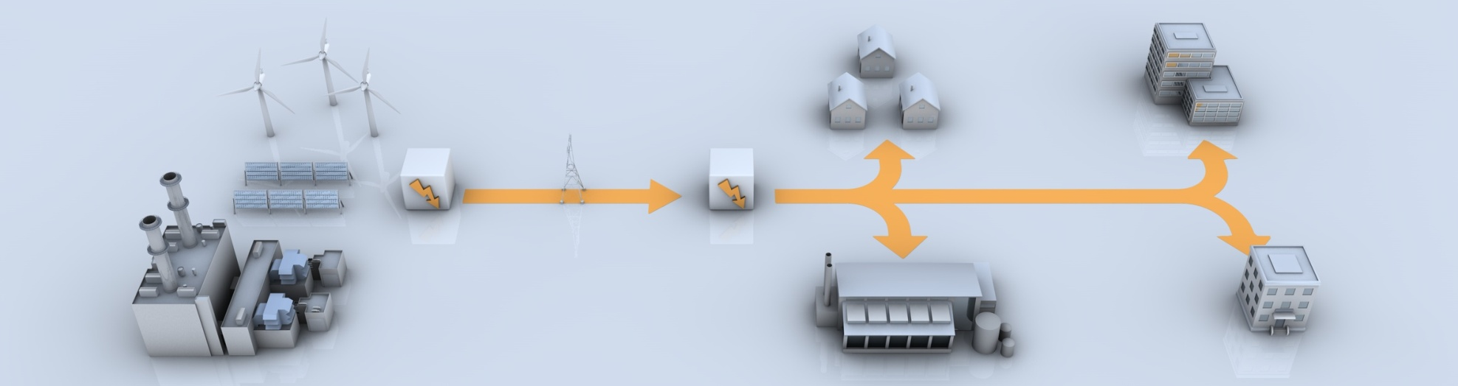
Today’s Grid
Before
One-way limited communication
One-way power flow
No electric vehicles
Centralized generation
Limited reactive power control
Few sensors and analog control
Little to no consumer choice
Reactive maintenance
Limited demand management
Limited T&D automation

Slide 3
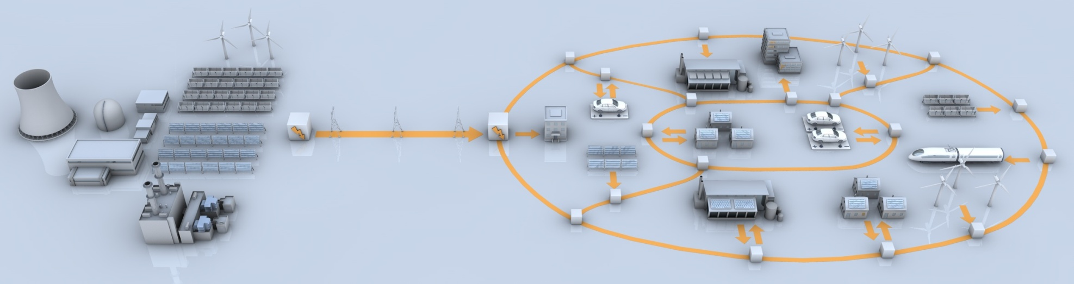
Tomorrow's Grid
Bi-directional communication
and metering
Bi-directional power flow
Millions of electric vehicles
Distribution automation
Intelligent reactive power control
Pervasive monitoring and digital control
Increased distributed generation
More consumer choices
Condition-based maintenance
Proliferation of demand management
After
Power
Information

Slide 4
Defining The Smart Grid
  Smart Grid- The integration and application of real-time monitoring, advanced sensing, communication, analytics and control enabling the dynamic flow of both energy and information to accommodate existing and new forms of supply, delivery, maintenance and use in a secure, reliable and efficient electric power system from generation to end-user.
The integration of two infrastructures… securely…
Electrical
Infrastructure
Information Infrastructure
Source: EPRI® Intelligrid

Slide 5
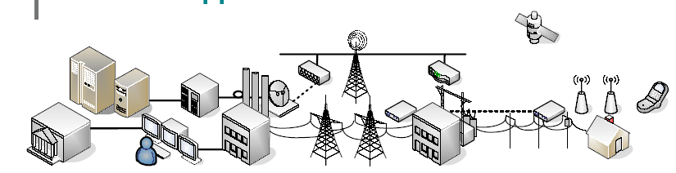
Strategic Focus … Enabling the ‘Smart Grid’
Objective: Maximize Customer Return on Assets and Operating Efficiency
Execute by Delivering the Smart Grid …
Asset Management
Grid Control
Data Collection & Local Control
Communications
Sensors
And Critical T&D Network Equipment

Slide 6
Anticipated Smart Grid Benefits*
Relative potential financial benefits …
Operational
Efficiency
Environmental
Impact
Energy Efficiency
Customer
Satisfaction
However, your mileage may vary.
*Model developed based on a study conducted with 31 global Utilities

Slide 7
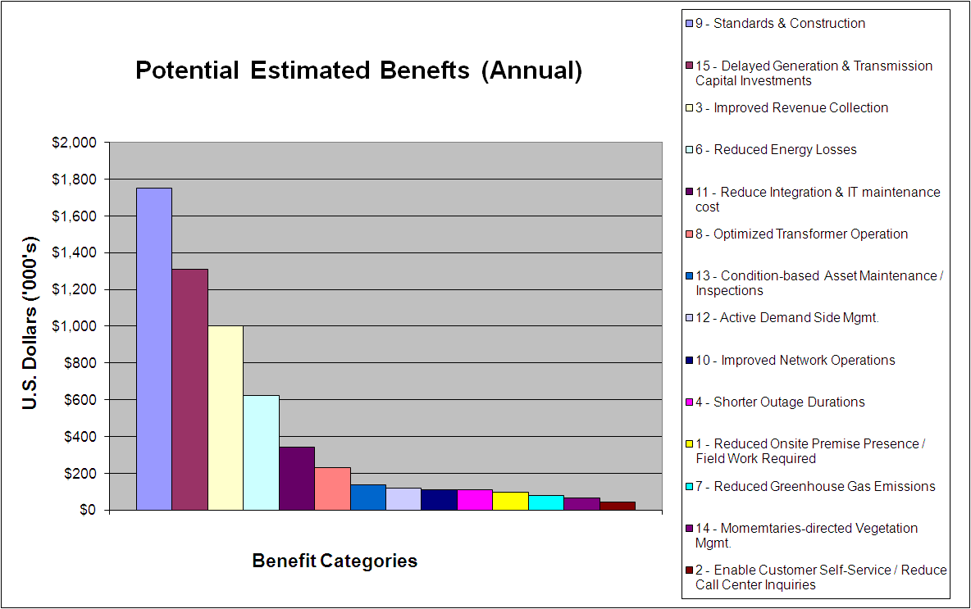
Smart Grid Potential Savings by Benefit Category
Average Annual Benefits to Utility (100K Customer Basis)

Slide 8
ARRA(Stimulus) Spending Overview
Energy Efficiency $16.8
Energy Delivery & Reliability $4.5
Loan Guarantees (Renewables) $6.0
Power Marketing Admin $3.3
Fossil Energy $3.4
R&D $2.0
$4.5B Allocated for Smart Grid Technology

Slide 9
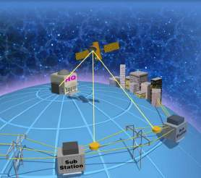
Requirements for a Smart Grid
  Self-Healing to correct problems early (DA)
  Interactive with consumers and markets (AMI)
  Optimized to make best use of resources
  Predictive to prevent emergencies (CBM)
  Distributed assets and information
  Integrated to merge all critical information
  More Secure from threats from all hazards (NERC)
Source: EPRI® Intelligrid
Notes:
How do we envision the future of the intelligent grid. It has to
“self healing” ….ability to respond to problems and correct the system automatically
“Interactive”…exchange real time pricing, bidding information, demand response so it acts as a real time “power exchange” (Similar to Stock exchange)
“optimized”…ability to run resource optimization problems online facilitating proper allocation of resources.
[ Use this example if required. For example reactive power sources should be close to where the loads are]
“Predictive”…moving away from being reactionary to predictive grid where maintenance can be pre scheduled well in advance
“Distributed”…assets allocation where required and load centers are. Allocation of information at different hierarchical levels to take control actions as necessary
“Integrated” …availability of critical information for actionable items
“Secure”…ability to respond and heal to threats due to natural causes or man made causes (terrorism…)
[These definitions are condensed and simplified from EPRI’s original vision on intelligent grid]

Slide 10

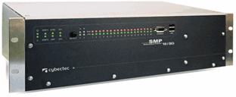
Substation Automation
From …
To …
SCADA
EMS
SCADA
EMS
PROTECTION
PROTECTION
ASSET MGMT
DEREGULATED
ASSET MGMT
DEREGULATED
PARTNERS
PARTNERS
LOCAL HMI
LOCAL HMI
Controls
Switchgear
Voltage Regs
Meters
Relays
Equipment
Power
Controls
Switchgear
Voltage Regs
Meters
Relays
Equipment
Power
Monitoring
Transformers, Breakers
Quality
Monitoring
Transformers, Breakers
Quality
IED (Controls and Relays) integration increases productivity:
Connects stranded islands of information with universal protocol translation
Centralizes access to all devices for security and efficiency
Eliminates redundant communication infrastructure

Slide 11
Evolution of Asset Maintenance
Condition Based Maintenance
Maintain when a potential failure is identified
Preventive Maintenance
Maintenance at a specific frequency
Calendar based Maintenance
Maintenance at a fixed frequency
Reactive Maintenance
Service assets as needed
Reactive
Proactive
Diagnostic/Analytic
1980’s
1990’s
21st Century

Slide 12
Equipment Failure Timing
Initial failures (installation problems, infant mortality of installed components).
Degradation over time (temperature, corrosion, dirt, surge)
Initial
Failures
Degradation
Failures
Likelihood
Of
Failure
Area under hatch marks represents the total likelihood of a failure
2.33 hrs/yr
(average)
Time
Notes:
You can further refine this by realizing that electrical equipment fails in known ways. Typically it fails very early in its life or very late. The later failures are due to equipment degradation due to usage.

Slide 13
Equipment Failure Timing
Poor maintenance reduces equipment life since failures due to degradation come prematurely soon. IEEE says add 10% to likelihood of downtime.
Initial
Failures
Early
Degradation
Failures
Likelihood of failure is higher because postponed maintenance increases problems due to corrosion, misalignment, etc, that would be picked up in a PM program
Likelihood
Of
Failure
2.59 hrs/yr
(average)
Time
Notes:
This equipment degradation can be accelerated if the equipment is exposed to non-optimal conditions or is not properly maintained. The result is that saving money on maintenance tends to shorten the useful life of the equipment. So, in addition to unexpected downtime expenses, premature failure of the equipment will increase capital costs by necessitating more frequent equipment replacement. We will now define these non-optimal conditions and how focusing maintenance effort by choosing the most important problems helps provide the best payback for our maintenance resources.

Slide 14
Equipment Outages Hours/Year
MV Transformers Win! (Lose?)

Slide 15
Outage Costs per Hour
Wireless Communications $41,000
Event Ticket sales $72,000
Airline reservations $90,000
Data Center $336,000
Merchant Power Plant 100 MW $410,000
Semiconductor manufacturer $2,000,000
Credit Card Processing Center $2,580,000
Investment Trading Operation $6,480,000

Slide 16
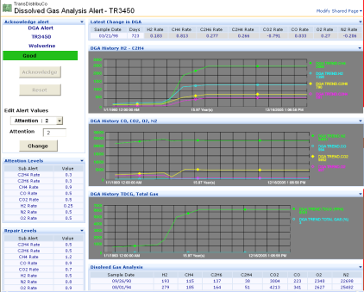
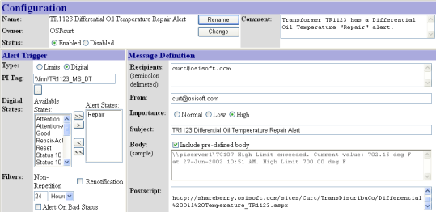
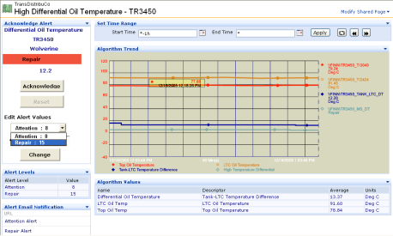
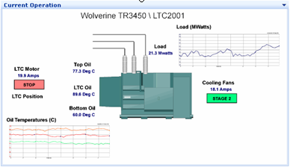
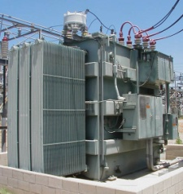
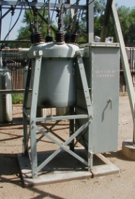
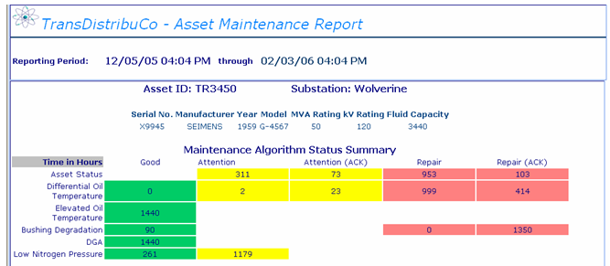
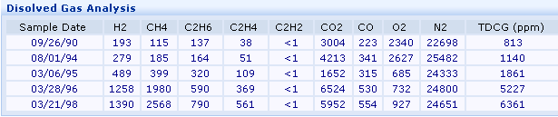
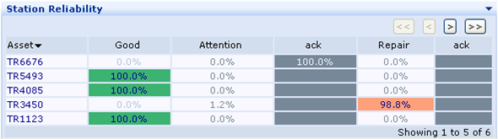
CBM: An Open and Scalable Environment
Integrated Asset
Information
Dashboard
Alert Notifications
Event Triggering
Maintenance or
Work Order Generation
Asset Information
Structure
Real-time Rule
Assessment
Asset Reliability
Improve Reliability and Quality
Notes:
Here, we are using an example of PI for CBM (Condition Based Maintenance) or Asset Management Process. But the concept or the idea here can apply to any initiatives, of any industries.
-Start from collecting, accessing, integrating, correlating and organizing your data from different data sources
-Perform analysis, apply rule-based engine
-Generate the automatic alarms, early warning, and triggers based on thresholds or assessment, it’s all “configurable”.
-Create the one-stop shop desktop enabled user interface, with overview, as well as drill-down capability
-Generate automatic reports for end users, which can also be used for regulatory or compliance purpose, etc.
-You can always go back to enhance your asset models and fine-tune your algorithms
This is a continuous process for improvement.

Slide 17
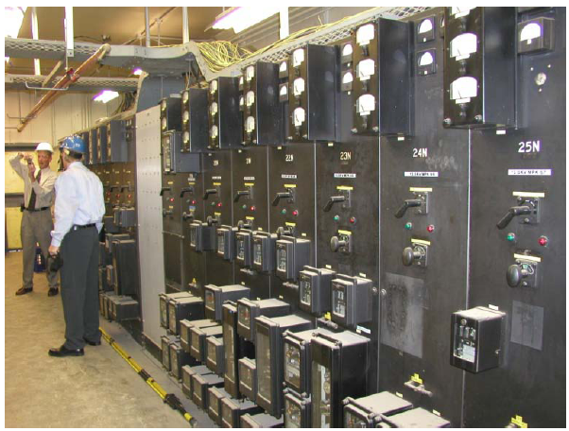
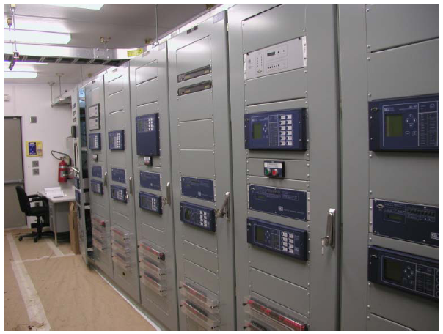
Where to Start

Slide 18
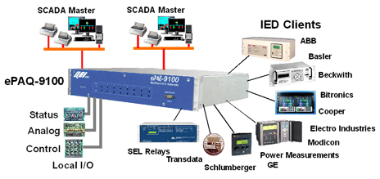
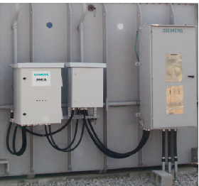
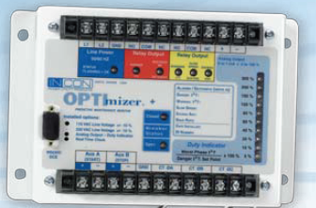
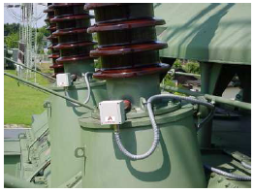
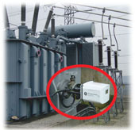
Equipment Monitoring IEDs
Relays, Meters & Controls
Transformer Monitor
Dissolved Gas Monitor
Breaker Monitor
Bushing Monitor

Slide 19
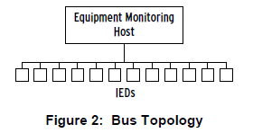
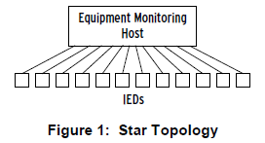
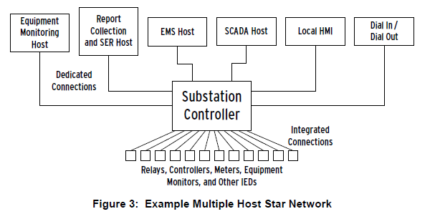
IED Communication

Slide 20
Substation LAN
Voltage Regulator
Feeder Breaker
Line Switch
Transformer
Cap Bank
S
DFR
CBC
VRC
RELAY
Gateways
SCADA/SMS
Switches
Switches
Router
Fiber, Wireless, Leased
Carrier Network

Slide 21
Distribution Automation Network Technologies Overview
DSDR Substation (300+)
Voltage Regulator
Feeder Breaker
Distribution Feeder (14k devices)
Transformer
S
PLC
S
VR
VRC
PR
Cap Bank
Cap Bank
Recloser
Sensor
Regulator
Gateway
PLC
Switch
Wireless Mesh, Peer2Peer, Point2MultiPt
Commercial
CDMA, GSM, WiMax
Router
Fiber, Wireless, MPLS
Carrier
Edge Network
Core Network
Carrier Edge Network
ICCP
EMS
DSCADA
VMS
FMS
DSM/AMI
Engineering
DCC
DMS

Slide 22
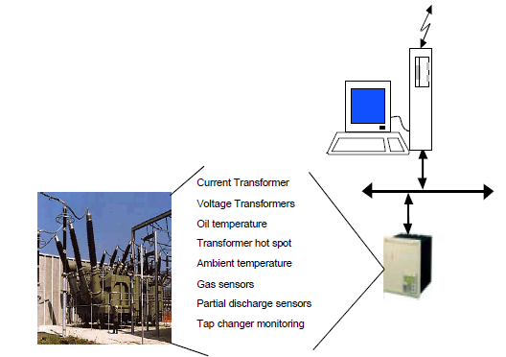
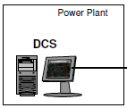
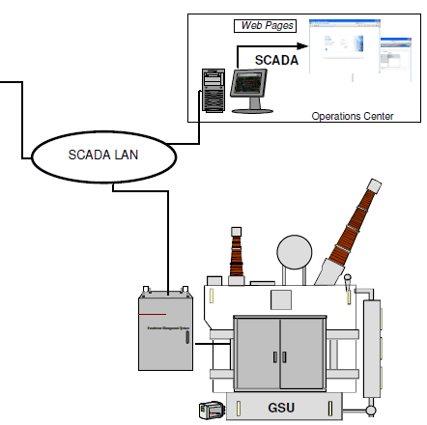
Critical Asset CBM

Slide 23
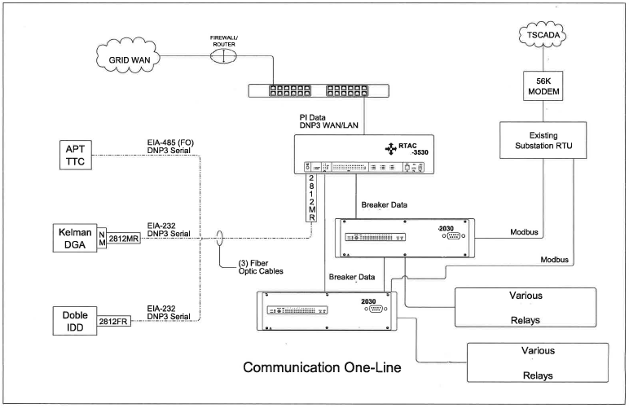
Recent CBM Project

Slide 24
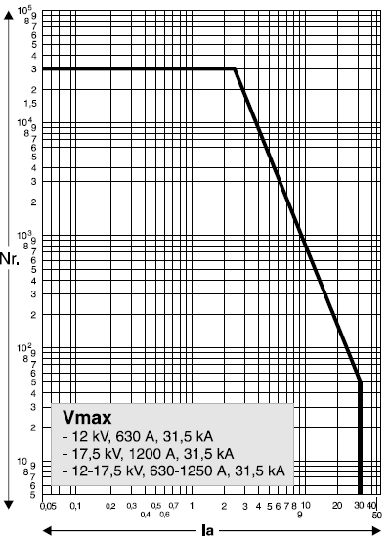
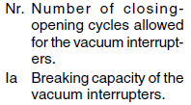
Circuit Breaker Life Curves

Slide 25
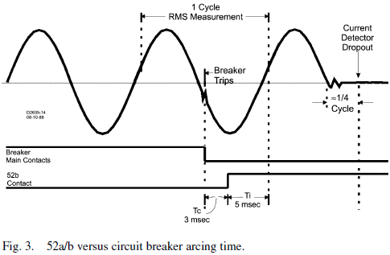
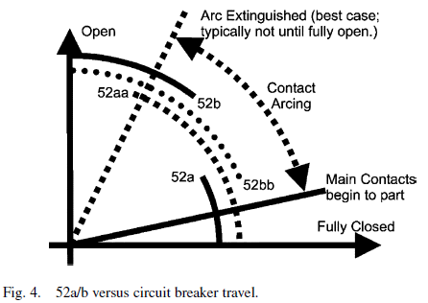


Circuit Breaker Wear

Slide 26
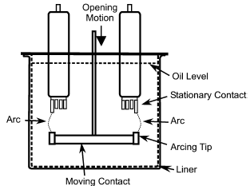
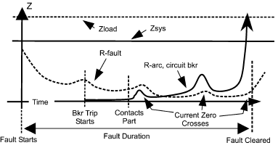
Application Issues
Variations in Circuit Breaker & Interrupter Design
CT Saturation; Relay filtering & sampling
Arcing time versus circuit breaker mechanism operation & 52a/b contact
Variations in arc resistance during fault clearing

Slide 27
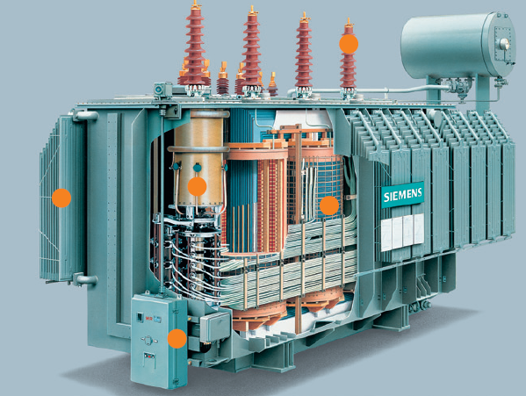
Transformer Monitoring

Slide 28
Transformer Failure Rate Data
Transformer Failure Causes

Slide 29
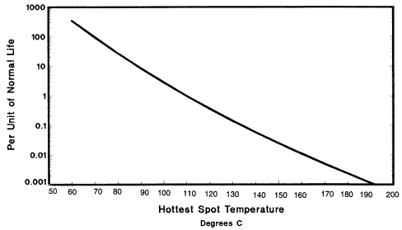
Transformer loading capability is limited primarily
by winding temperature; because it is not uniform
the hottest spot of the winding is the limiting factor.
Transformers utilize cellulose insulation systems
that have a hot spot temperature rating of 110
degrees C. The IEEE Loading Guide provides
detailed calculation methods to determine transformer
life for specific user situations.
IEEE C57.91
Loading Guide for Oil Filled Transformers

Slide 30
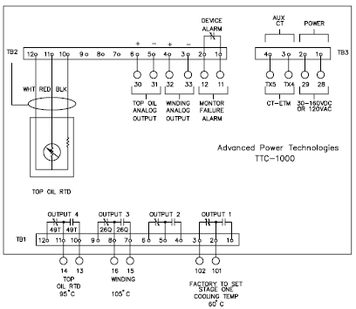
Microprocessor based system can
calculate winding temperature from
IEEE formulas utilizing top oil
temperature, a CT input & transformer
data from factory test or estimates.
Transformer Temperature Monitor

Slide 31
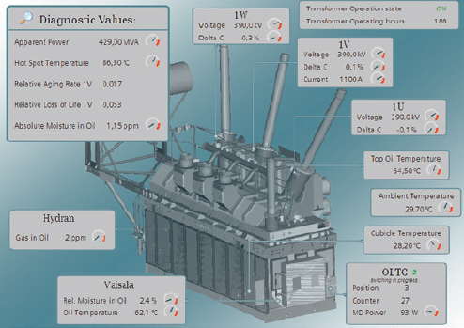
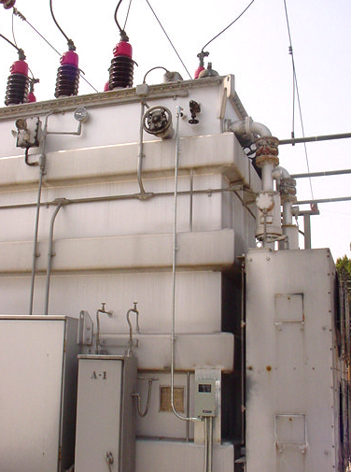
Monitor Installation & Graphic Display

Slide 32
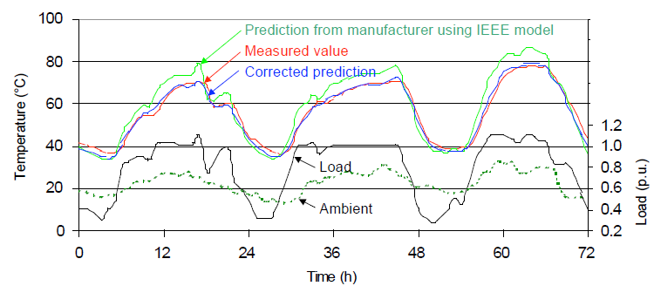
Transformer Temperature Measurement

Slide 33
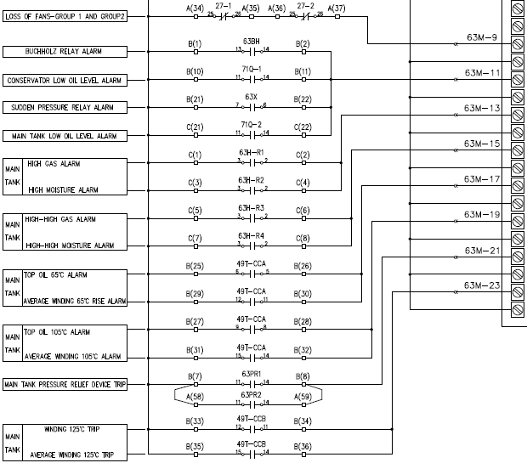
Transformer Monitor as Annunciator

Slide 34
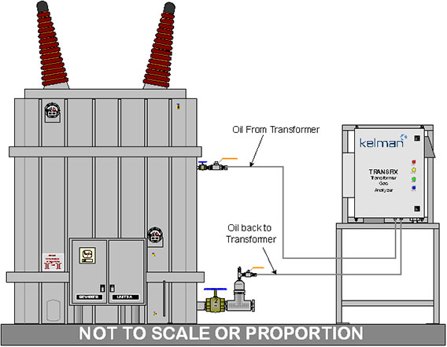
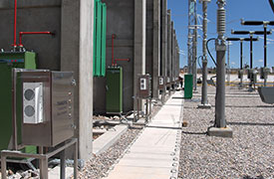
DGA Monitor

Slide 35
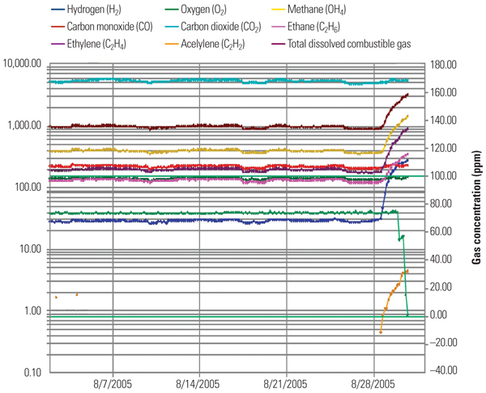
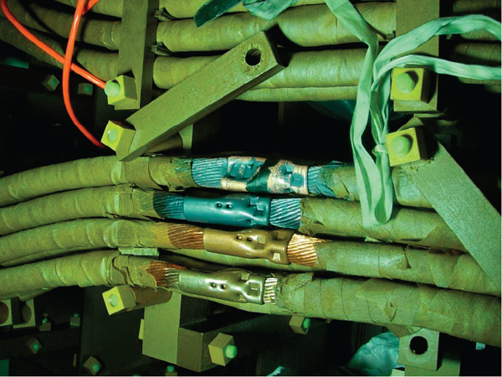
DGA Example

Slide 36
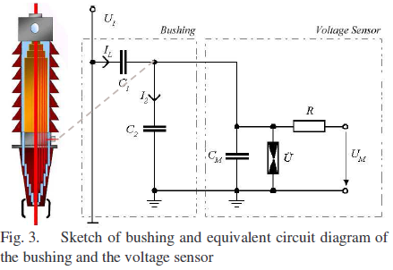
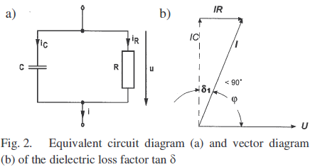

Bushing Monitor

Slide 37



Bushing Monitor Installation

Slide 38

Food for Thought

